Slide 1
Tools and Services Workshop
Data Store – Managing Your ‘Big’ Data

Slide 2

Welcome to the Data Store
Manage and share your data across all CyVerse platforms

Slide 3
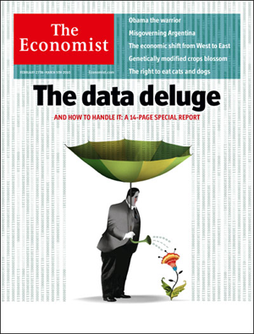

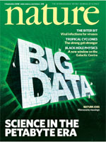
Working with Big Data
Challenges: the scope and scale of life sciences data continue to grow
Big data a term applied to data sets whose size is beyond the ability of commonly used software tools to capture, manage, and process the data within a tolerable elapsed time
Big data sizes are a constantly moving target currently ranging from a few dozen terabytes (TB) to many petabytes of data in a single data set.
“‘Big Data': Big gaps of knowledge in the field of Internet". International Journal of Internet Science 7: 1–5.
Notes:
Snijders, C.; Matzat, U.; Reips, U.-D. (2012). "'Big Data': Big gaps of knowledge in the field of Internet". International Journal of Internet Science 7: 1–5.

Slide 4
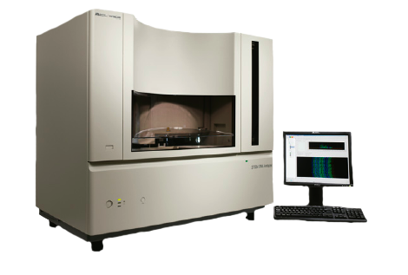
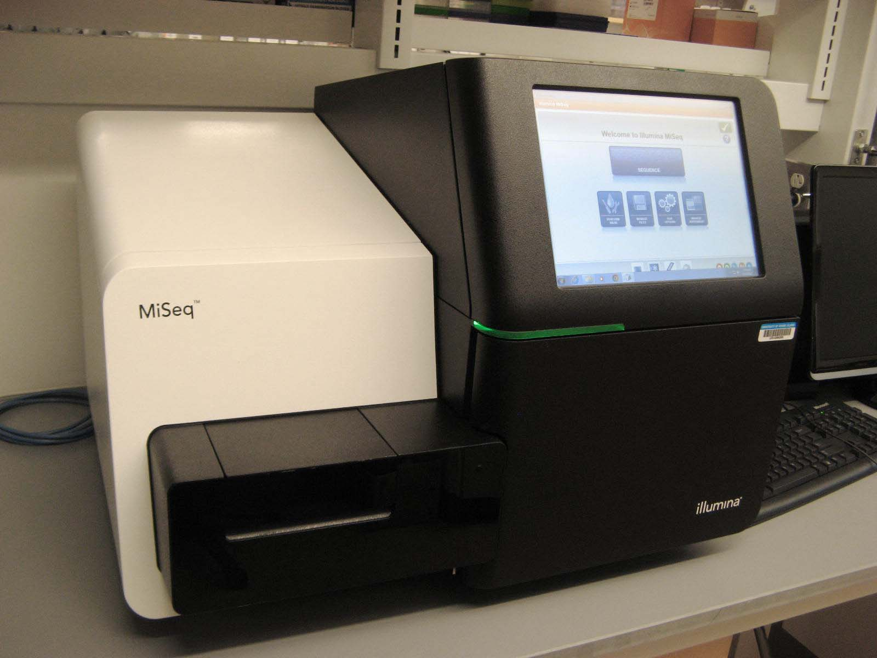
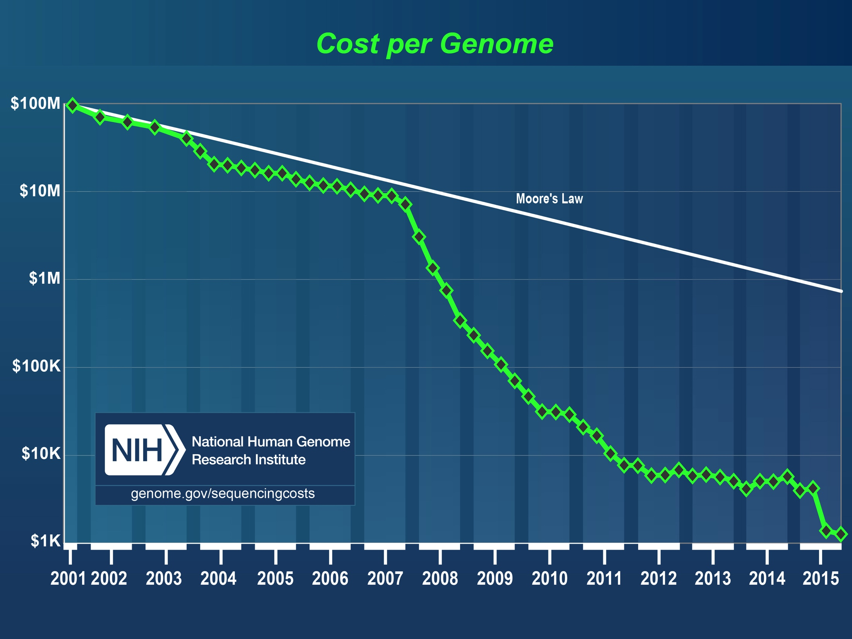
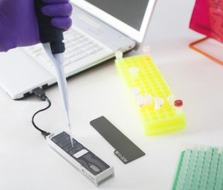
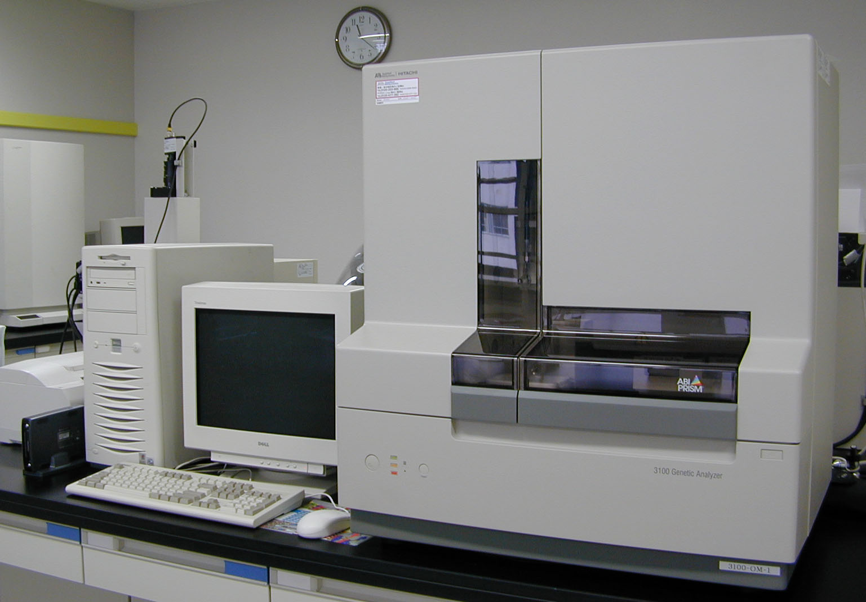
Working with Big Data
Challenges: data generation is cheaper and faster
http://www.genome.gov/sequencingcosts/

Slide 5
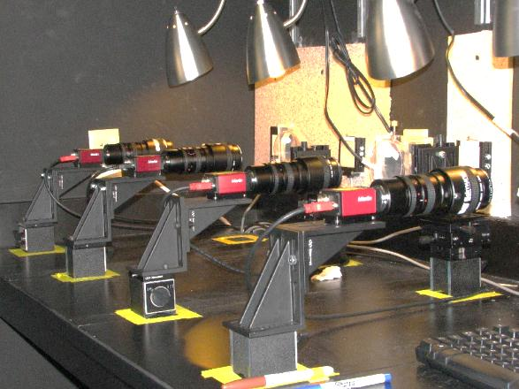
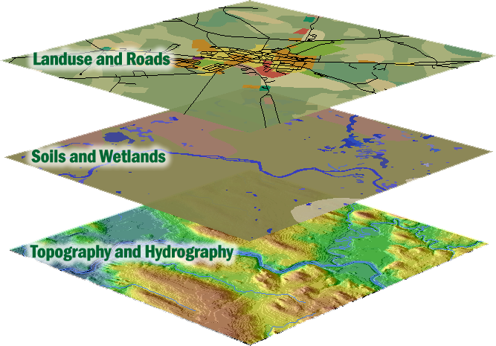
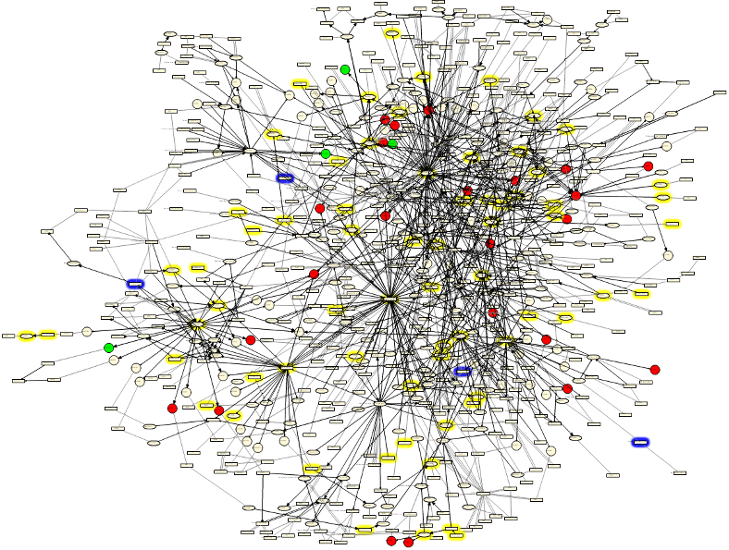
Working with Big Data
Challenge: biology encompasses more than sequence data
Advanced Imaging Geospatial Network
Biologists work with and require access to diverse data types

Slide 6
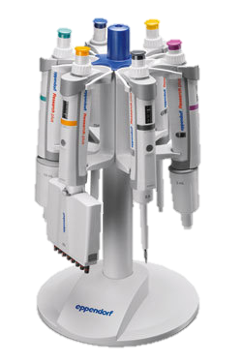
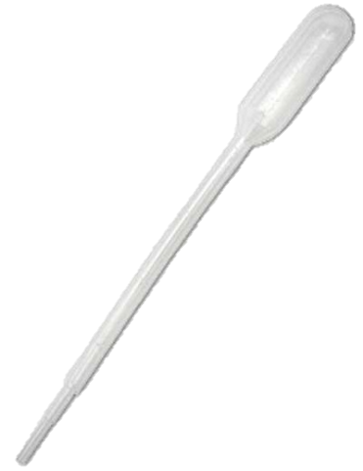

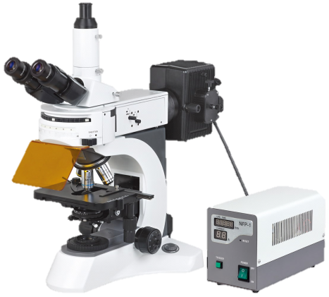
Working with Big Data
Challenges: changes in data require changes in tools
Difficult / slow transfers
Expense for storage / backup
Difficult to share and publish
Analysis
Metadata (What Is metadata?)
Changes in scale introduce quantitative and qualitative complications

Slide 7
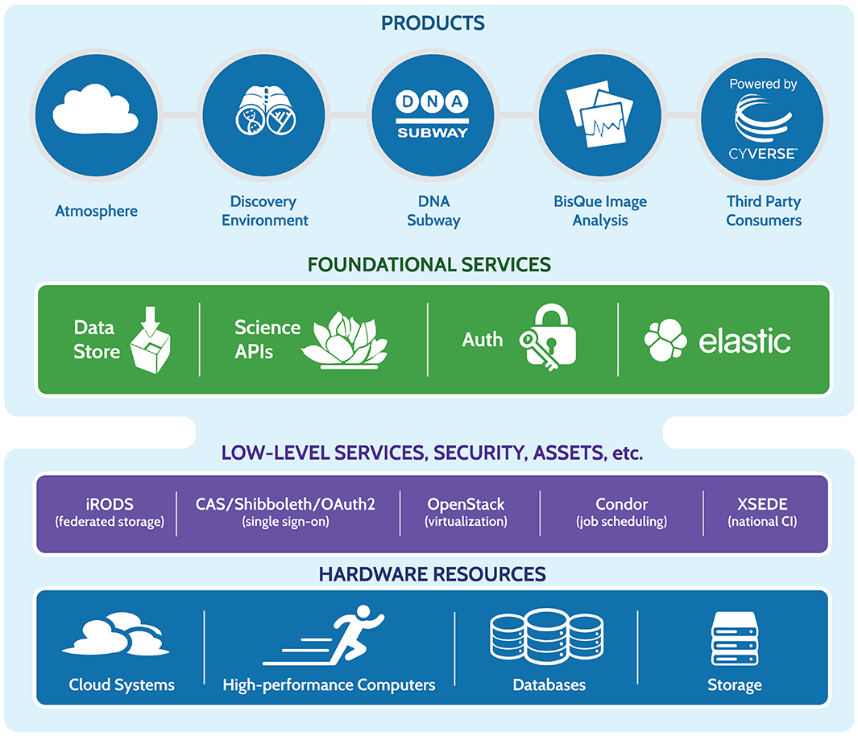
Data Store Overview
The Data Store services all CyVerse platforms
Access your data from multiple CyVerse services
Automatic backup (redundant between University of Arizona and University of Texas
Default 100 GB allocation, > 1 TB allocations available with justification

Slide 8
Data lifecycle support
Discovery
Upload
Data Commons Repository (DCR), Elasticsearch
Discovery Environment, iCommands, Cyberduck
Metadata
Publication
Add, delete, copy; metadata templates; bulk metadata
Analysis
Data Commons Repository (DCR), NCBI-SRA
Discovery Environment, Atmosphere, Agave API, BisQue, DNA Subway
Sharing
Community Data folders, Data Commons, quick share links

Slide 9



Data Store Overview
Benefits
Get Science Done
Store any type of files related to your research
An evolving “Data Commons” lets you access important datasets
Reproducibility
Metadata captures information needed for reproducibility
Automatic backup and accessibility support your project’s data management plan
Productivity
iRODS makes high-speed transfers possible (100 GB in ~30 min)
Share data instantly with collaborators within CyVerse

Slide 10
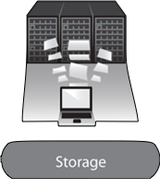
Data Store Overview
Some important things we will not “see” in the demo
Data Backups
Data Transfer
Source | Destination | Copy Method | Time (seconds)
CD | My Computer | cp | 320
Berkeley Server | My Computer | scp | 150
External Drive | My Computer | cp | 36
USB 2.0 Flash | My Computer | cp | 30
Data Store | My Computer | iget | 18
My Computer | My Computer | cp | 15
Arizona
Texas
Key component of your data management
Worry-free
Closer to optimum conditions: transfers between University of Arizona and UC Berkeley
100 GB: 26m15s, 1 GB 17.5s

Slide 11
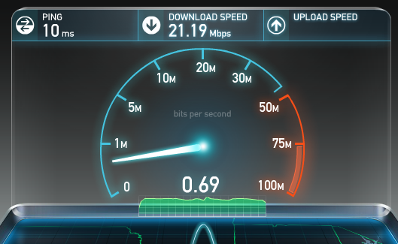
Data Store Overview
Some important things we will not “see” in the demo
http://www.speedtest.net/
Local connections and institutional policies limit data transfer

Slide 12
Getting Data into CyVerse

Slide 13

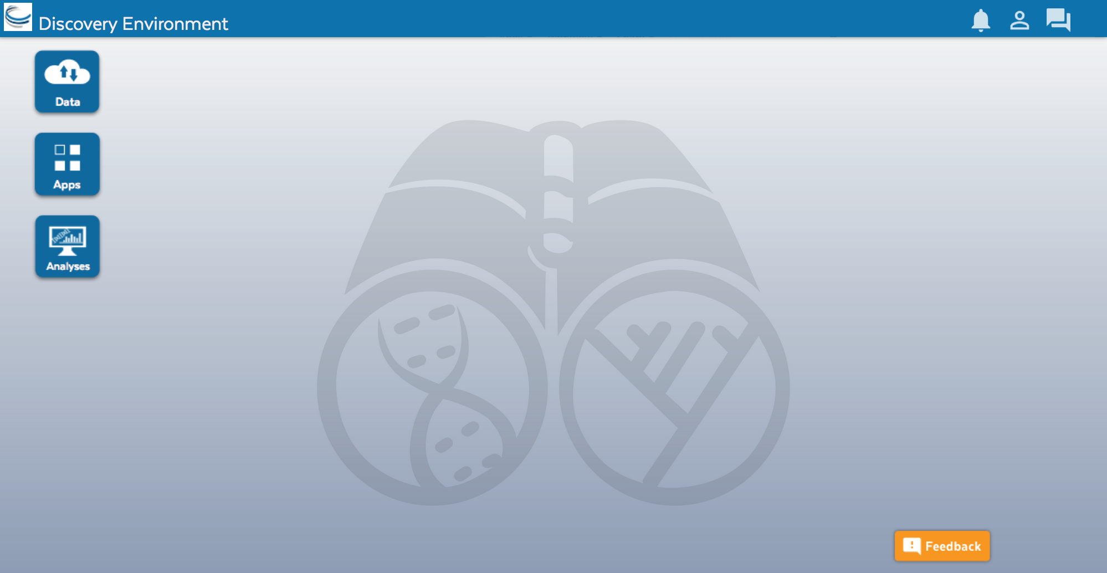
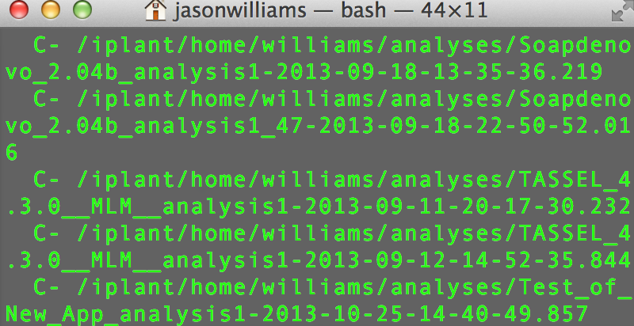
CyVerse Data Store
Multiple ways to access
Point-and-click
Command line
Cyberduck Discovery Environment
iCommands

Slide 14
Discovery Environment
Simple upload/download for small files
Bulk upload files and folders (<10GB)
Import from URL (no size limit)
Advantage + Disadvantage -
Covers most upload/download sharing needs
Some size/speed limitations

Slide 15
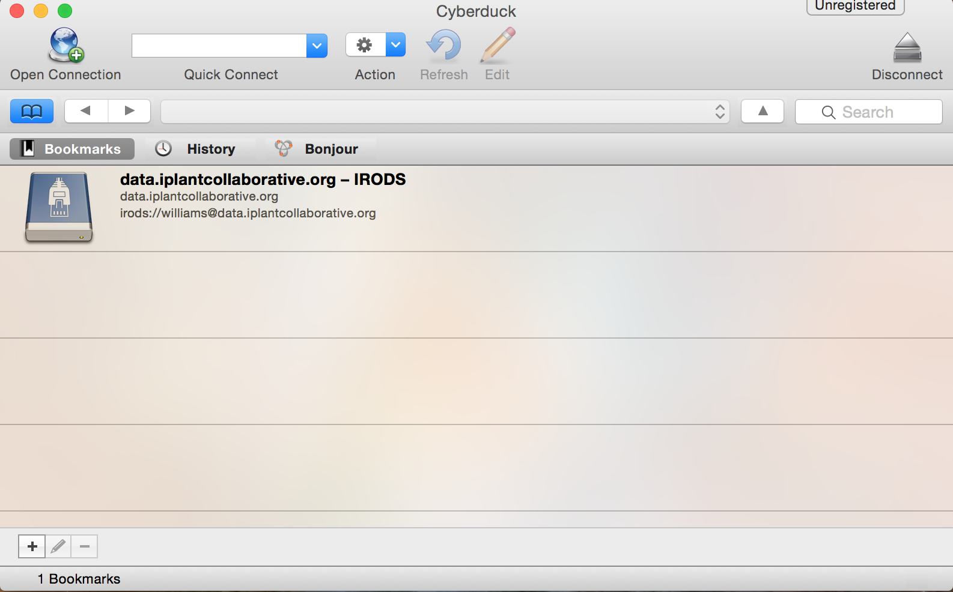
Cyberduck
Drag and drop files and folders
No size limit, file editing/previews
Easy Desktop functionality
Advantage + Disadvantage -
More like desktop file systems
No permissions/metadata control

Slide 16
iCommands
Full flexibility
Ability to script and automate
Access from terminal/server
Advantage + Disadvantage -
Customizability
Requires some command line expertise

